Slide 1
EE-2003 Computer Organization & Assembly Language
INSTRUCTOR
Engr. Aashir Mahboob
Lecturer, Department of Computer Science
Office: Room No: 16, Opposite HoD (CS) Office
FAST NUCES (Karachi)
Aashir.mahboob@nu.edu.pk

Slide 2
Chapter No: 06
Conditional Processing

Slide 3
Bit-wise Operations
Notes:
Bit Masking

Slide 4
Status Flags (Revision)
• The Zero flag is set when the result of an operation equals zero.
• The Carry flag is set when an instruction generates a result that is too large (or too small) for the destination operand.
• The Sign flag is set if the destination operand is negative, and it is clear if the destination operand is positive.
• The Overflow flag is set when an instruction generates an invalid signed result.
• The Parity flag is set when an instruction generates an even number of 1 bits in the low byte of the destination operand.
• The Auxiliary Carry flag is set when an operation produces a carry out from bit 3 to bit 4.

Slide 5
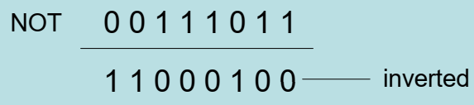

NOT Instruction
Performs a bitwise Boolean NOT operation on a single destination operand
Syntax: (no flag affected)
NOT destination
Example:
mov al 11110000b
NOT al

Slide 6
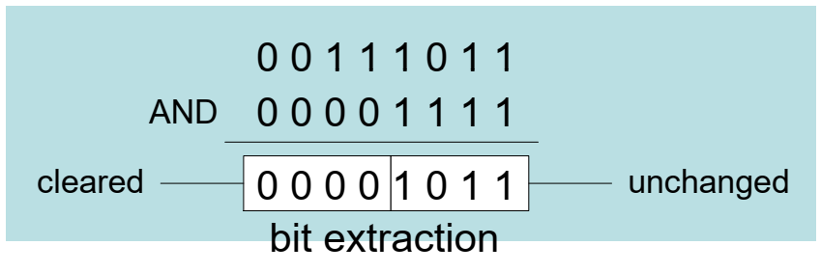
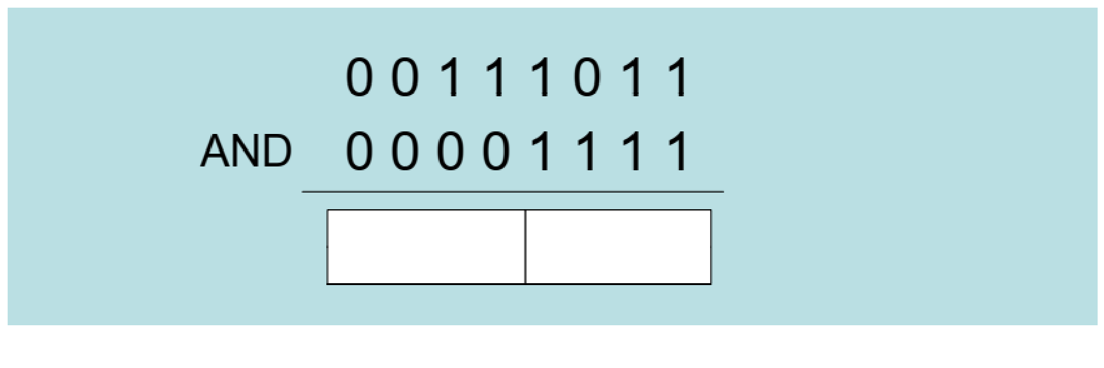
AND Instruction
Performs a bitwise Boolean AND operation between each pair of matching bits in two operands
AND instruction always clears Overflow and Carry flag. Also can modify Sign, Zero, and Parity in a way that is consistent with the value assigned to the destination operand.
Syntax: AND destination, source
Example:
mov al, 00111011b
and al, 00001111b

Slide 7
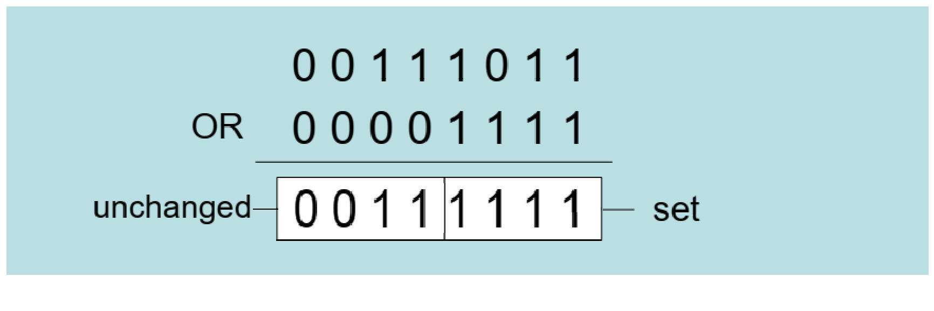
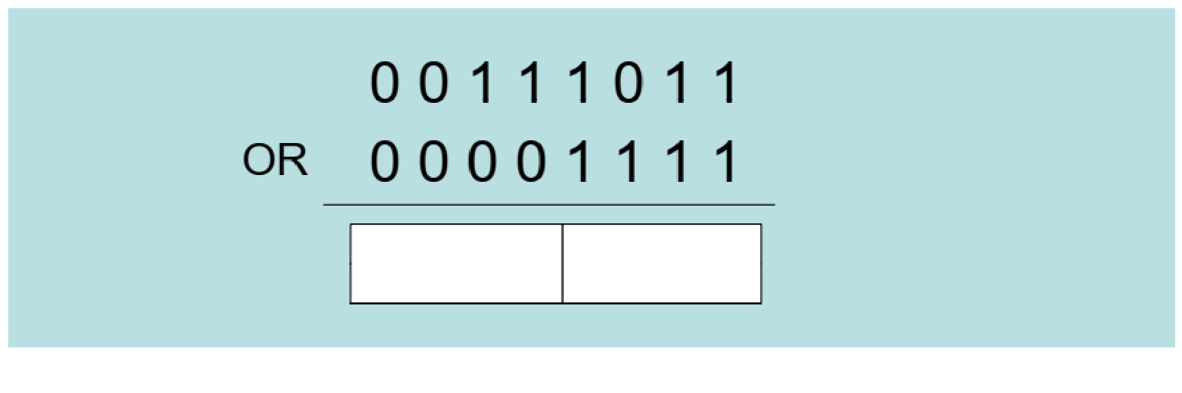
OR Instruction
Performs a bitwise Boolean OR operation between each pair of matching bits in two operands
Syntax: Clears Overflow, Cary . Modifies Sign, Zero, and Parity in a way that is consistent with the value assigned to the destination operand
Syntax: OR destination, source
Example:
mov al, 00111011b
or al, 00001111b

Slide 8
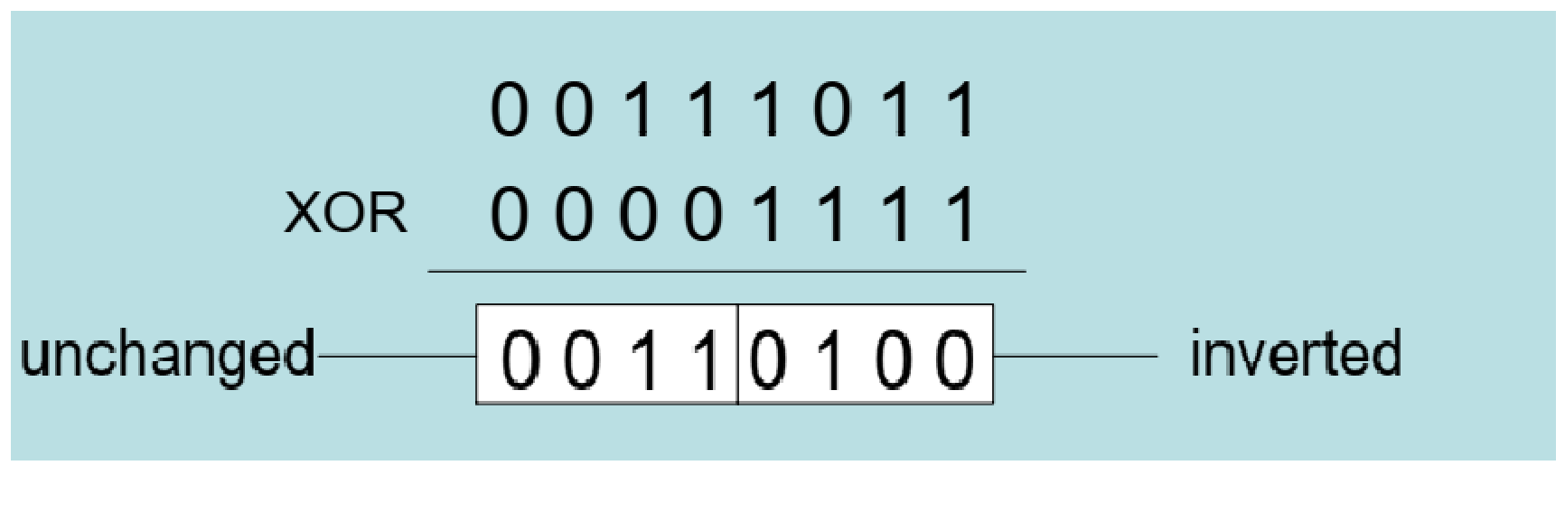
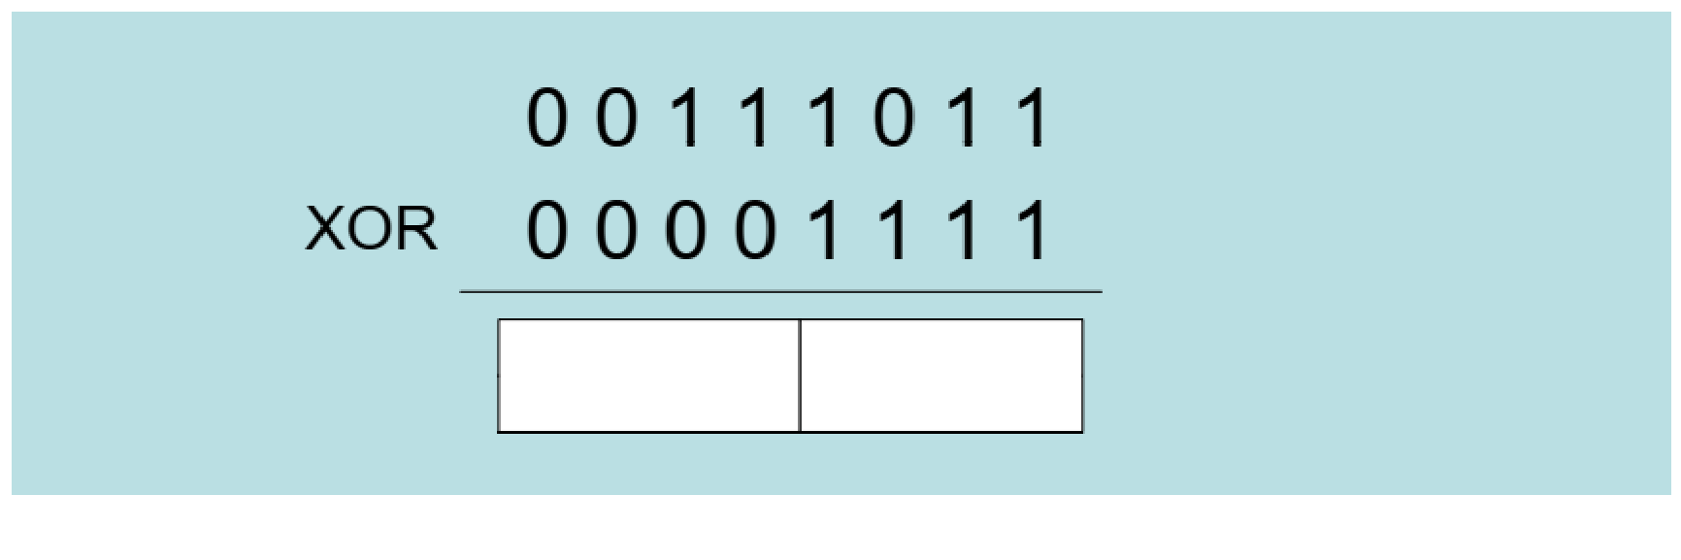
XOR Instruction
Performs a bitwise Boolean XOR operation between each pair of matching bits in two operands
The XOR instruction always clears the Overflow and Carry flags.
Syntax: XOR destination, source
Example:
mov al, 00111011b
xor al, 00001111b
XOR is a useful way to invert the bits in an operand and data encryption

Slide 9
Applications
Convert the character in AL to upper case
Solution: Use the AND instruction to clear bit 5
mov al , 'a’ ; AL = 01100001b
and al , 11011111b ; AL = 01000001b
Convert a binary decimal byte into its equivalent ASCII decimal digit
Solution: Use the OR instruction to set bits 4 and 5
mov al , 6 ; AL = 00000110b
or al , 00110000b ; AL = 00110110b
Jump to a label if an integer is even
Solution: AND the lowest bit with a 1, If the result is Zero, the number was even
mov ax , wordVal
and ax , 1 ; low bit set?
jz EvenValue ; jump if Zero flag

Slide 10
Applications
Jump to a label if the value in AL is not zero
Solution: OR the byte with itself, then use the JNZ (jump if not zero) instruction
or al , al
jnz IsNotZero ; jump if not zero

Slide 11
Non-Destructive Instructions
Notes:
Bit Masking

Slide 12
TEST Instruction
Performs a nondestructive AND operation between each pair of matching bits in two operands
No operands are modified, but the flags are affected
The TEST instruction always clears the Overflow and Carry flags
Example: jump to a label if either bit 0 or bit 1 in AL is set
test al, 00000011b
jnz ValueFound
Example: jump to a label if neither bit 0 nor bit 1 in AL is set
test al, 00000011b
jz ValueNotFound

Slide 13
CMP Instruction
Compares the destination operand to the source operand
Nondestructive subtraction of source from destination (destination operand is not changed)
Syntax:
CMP destination, source
Example: destination == source
mov al , 5
cmp al , 5 ; Zero flag set
Example: destination < source
mov al , 4
cmp al , 5 ; Carry flag set
Example: destination > source
mov al , 6
cmp al , 5 ; ZF = 0, CF = 0
The comparisons shown so far were unsigned

Slide 14
CMP Instruction
The comparisons shown here are performed with signed integers
Example: destination > source
mov al , 5
cmp al , -2 ; Sign flag == Overflow flag
Example: destination < source
mov al , -1
cmp al , 5 ; Sign flag != Overflow flag

Slide 15
Conditions and Output
Unsigned | ZF | CF
destination < source | 0 | 1
destination > source | 0 | 0
destination = source | 1 | 0
Signed | FLAGS
destination < source | SF != OF
destination > source | SF == OF
destination = source | ZF = 1

Slide 16
Setting and Clearing Individual Flags
and al , 0 ; set Zero
or al , 1 ; clear Zero
or al , 80h ; set Sign
and al , 7Fh ; clear Sign
stc ; set Carry
clc ; clear Carry
mov al , 7Fh
inc al ; set Overflow
or eax , 0 ; clear Overflow

Slide 17
Conditional jumps

Slide 18
Conditional Structures
There are no high-level logic structures such as if-then-else, in the IA-32 instruction set
But, you can use combinations of comparisons and jumps to implement any logic structure
First, an operation such as CMP, AND or SUB is executed to modified the CPU flags
Second, a conditional jump instruction tests the flags and changes the execution flow accordingly
Example:
cmp eax,0 and dl,10110000b
jz L1 ; jump if ZF = 1 jnz L2 ; jump if ZF = 0
. . ….
L1: L2:

Slide 19
Jcond Instructions
A conditional jump instruction branches to a label when specific register or flag conditions are met
Jcond Destination
Four groups: (some are the same)
based on specific flag values
based on equality between operands
based on comparisons of unsigned operands
based on comparisons of signed operands

Slide 20
Jumps Based on Specific Flags
Flag | Instruction | Description | Flag Status
ZERO | JZ | Jump if zero | ZF = 1
 | JNZ | Jump if not zero | ZF = 0
CARRY | JC | Jump if carry | CF = 1
 | JNC | Jump if not carry | CF = 0
Over-Flow | JO | Jump if overflow | OF = 1
 | JNO | Jump if not overflow | OF = 0
SIGN | JS | Jump if sign | SF = 1
 | JNS | Jump if not sign | SF = 0
PARITY | JP | Jump if parity (even) | PF = 1
 | JNP | Jump if not parity (odd) | PF = 0

Slide 21
Jumps Based on Equality
Instruction | Description
JE | Jump if equal (left OP = right OP)
JNE
JCXZ | Jump if CX = 0
JECXZ | Jump if ECX = 0

Slide 22
Jumps Based on Un-signed Comparison
Condition | Instruction | Description
 | JA
 | JNA
 | JAE
 | JNAE
 | JB
 | JNB
 | JBE
 | JNBE

Slide 23
Jumps Based on Signed Comparison
Condition | Instruction | Description
 | JG
 | JNG
 | JGE
 | JNGE
 | JL
 | JNL
 | JLE
 | JNLE

Slide 24
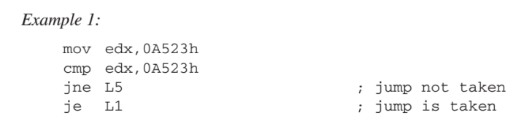
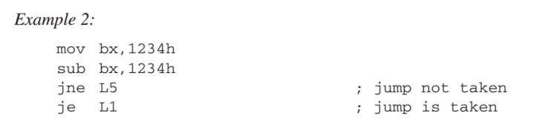
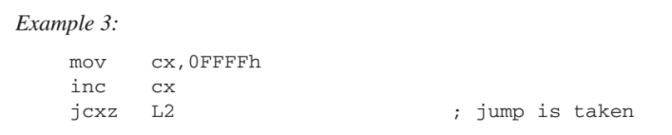
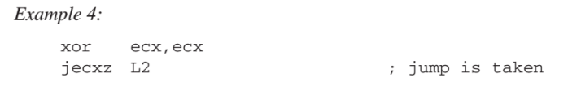
EXAMPLES

Slide 25
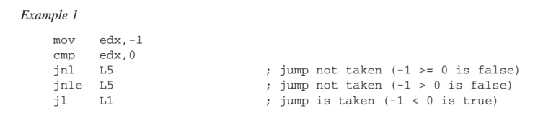
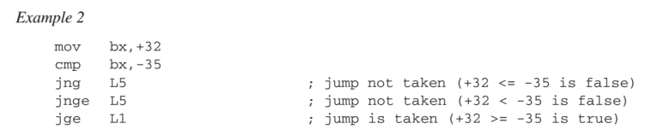
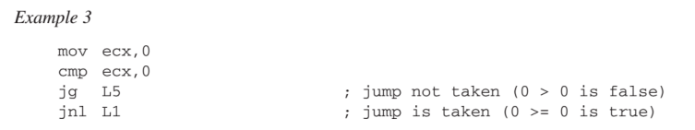
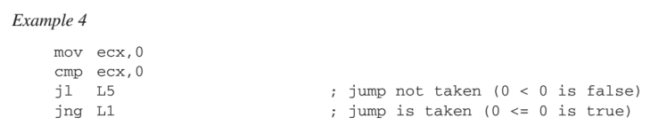
EXAMPLES (Signed CMP)

Slide 26
Examples
Compare unsigned AX to BX, and copy the larger of the two into a variable named Large
Solution:
mov Large , bx
cmp ax , bx
jna Next
mov Large , ax
Next:
Compare signed AX to BX, and copy the smaller of the two into a variable named small
Solution:
mov small , ax
cmp bx , ax
jnl Next
mov small , bx
Next:

Slide 27
Examples
Find the first even number in an array of unsigned Integers
Solution:
.date
intArray DWORD 7, 9, 3, 4, 6, 1
.code
...
mov ebx, OFFSET intArray
mov ecx, LENGTHOF intArray
L1: test DWORD PTR [ebx], 1
jz found
add ebx, 4
loop L1
...
Found:

Slide 28
Conditional Structures

Slide 29
If Statements
If then else
JNE esle
JMP endif
else:
endif:
Condition
Then
Else
Condition
Then
Else

Slide 30
Block-structured If Statements
Assembly language programmers can easily translate logical statements written in C++ into assembly language. For example
JNE else
JMP endif
else:
Endif:
JNE else
JMP endif
else:
Endif:
Condition
Mov EAX, op1
CMP EAX, op2
if( op1 == op2 )
X = 1;
else
X = 2;
Then
MOV X , 1
Else
MOV X , 2

Slide 31
Exercise
Implement the following pseudocode in assembly language, all values are unsigned:
if( ebx <= ecx )
{
eax = 5;
edx = 6;
}
JA endif
Endif:
CMP EBX, ECX
MOV EAX , 5
MOV EDX , 6

Slide 32
Exercise
Implement the following pseudocode in assembly language, all values are 32-bit signed integer
JG else
JMP endif
else:
Endif:
JLE if
JMP endif
if:
Endif:
Mov EAX, var1
CMP EAX, var2
Mov EAX, var1
CMP EAX, var2
if( va1 <= var2 )
var3 = 10;
else
{
var3 = 6;
var4 = 7;
}
MOV var3 , 10
MOV var3 , 6
MOV var4 , 7
MOV var3 , 6
MOV var4 , 7
MOV var3 , 10

Slide 33
Compound Expression with AND
When implementing the logical AND operator, consider that HLLs use short-circuit evaluation
In the following example, if the first expression is false, the second expression is skipped
if(al > bl && bl > cl)
X = 1;
cmp al,bl ;1st expression
ja L1
jmp next
L1:
cmp bl,cl ;2nd expression
ja L2
jmp next
L2: ; both are true
mov X,1 ; set X to 1
next:
cmp al,bl ;1st expression
jbe next
cmp bl,cl ;2nd expression
jbe next
mov X,1 ; set X to 1
next:

Slide 34
Compound Expression with OR
In the following example, if the first expression is true, the second expression is skipped
if(al > bl || bl > cl)
X = 1;
cmp al,bl ;1st expression
jbe L1
jmp L2
L1:
cmp bl,cl ;2nd expression
jbe next
L2: ; both are true
mov X,1 ; set X to 1
next:
cmp al,bl ;1st expression
ja L1
cmp bl,cl ;2nd expression
jbe next
L1:
mov X,1 ; set X to 1
next:

Slide 35
Exercise
Implement the following pseudocode in assembly language, all values are unsigned:
Endif:
if( ebx <= ecx && ecx > edx)
{
eax = 5;
edx = 6;
}
CMP EBX, ECX
JA endif
CMP ECX, EDX
JBE endif
MOV EAX , 5
MOV EDX , 6

Slide 36
While Loop
A WHILE loop is really an IF statement followed by the body of the loop followed by an unconditional jump to the top of the loop
Consider the following example
_While:
Jmp _while
_endwhile:
while( eax < ebx)
eax = eax + 1;
CMP EAX, EBX
JAE _endwhile
Inc EAX

Slide 37
While Loop
A WHILE loop is really an IF statement followed by the body of the loop followed by an unconditional jump to the top of the loop
Consider the following example
_While:
Jmp _while
_endwhile:
while( eax < ebx)
eax = eax + 1;
CMP EAX, EBX
JAE _endwhile
Inc EAX

Slide 38
Exercise
Implement the following loop, using unsigned 32-bit integer
_While:
Jmp _while
_endwhile:
while( ebx <= val1)
{
eax++;
if (ebx == ecx)
X=2;
else
X=3;
}
CMP EbX, val1
JA _endwhile
INC EAX
CMP EBX, ECX
JNE else
MOV X, 2
Jmp _while
else:
MOV X, 3

Slide 39
Do Loop
A DO loop is really an IF statement, here the body of the loop followed by an IF statement to unconditional jump
Consider the following example
_do:
Jmp _do
_enddo:
Do
{
eax = eax + 1;
}while( eax < ebx)
Inc EAX
CMP EAX, EBX
JAE _enddo

Slide 40

BT (Bit Test) Instruction
Copies bit n from an operand into the Carry flag
Syntax:
BT bitBase, n
bitBase may be r/m16 or r/m32
n may be r16, r32, or imm8
• Example:
jump to label L1 if bit 9 is set in the AX register:

Slide 41
BT (Bit Test) Instruction
BTC bitBase, n : bit test and complement
BTR bitBase, n : bit test and reset (clear)
BTS bitBase, n : bit test and set
BTC copies bit n to the Carry flag and complements bit n in the destination operand.
BTR copies bit n to the Carry flag and clears bit n in the destination.
BTS copies bit n to the Carry flag and sets bit n in the destination.

Slide 42
LOOPZ and LOOPE (Conditional Loops)
Syntax:
LOOPE destination
LOOPZ destination
Logic:
ECX ⟵ ECX – 1
if ECX != 0 and ZF=1, jump to destination
The destination label must be between -128 and +127 bytes from the location of the following instruction
Useful when scanning an array for the first element that meets some condition.

Slide 43
LOOPNZ and LOOPNE
Syntax:
LOOPNZ destination
LOOPNE destination
Logic:
ECX ⟵ ECX – 1;
if ECX != 0 and ZF=0, jump to destination

Slide 44
Example 1:
Write assembly code that finds the first positive value in an array.

Slide 45
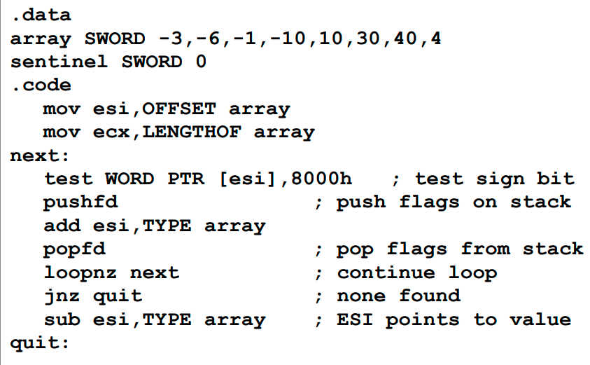
Example 1:
If no value is found then after adding 2 to the ESI it points to sentinel, so we need to skip the next line
Write assembly code that finds the first positive value in an array:
ESI was incremented due to which it points to the next value rather than the desired value after the loop terminates. In this step we are subtracting its value by 2 so that it points to the first non negative value in array.
In this code the ESI points to the desired value, There are 2 situations:
If positive value is found it points to the desired value.
If no value is found it points to the sentinel

Slide 46
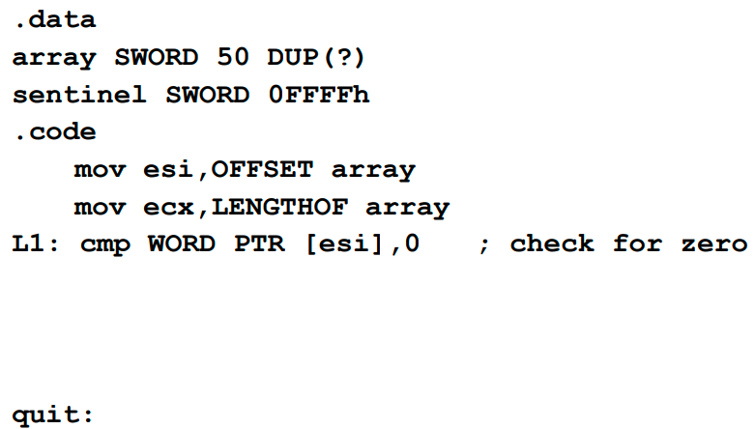
Example 2:
Locate the first nonzero value in the array. If none is found, let ESI point to the sentinel value:

Slide 47
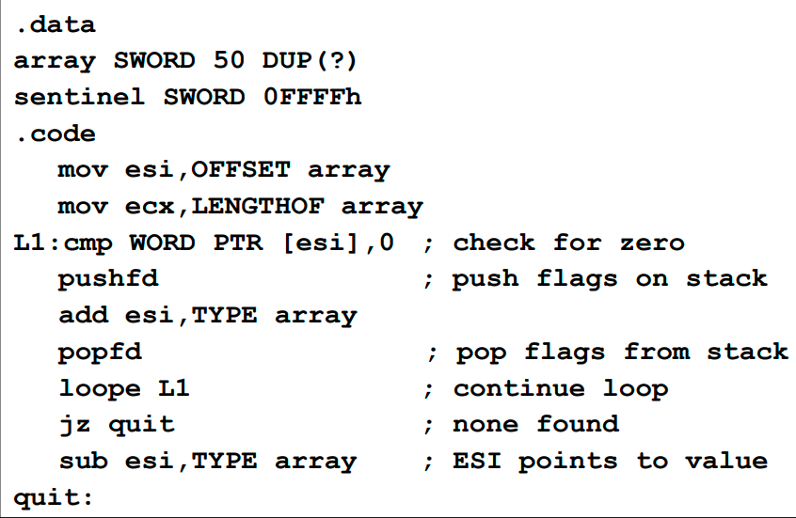
Solution:

Slide 48
Example 1:
If no value is found then after adding 2 to the ESI it points to sentinel, so we need to skip the next line
Write assembly code that finds the first positive value in an array:
ESI was incremented due to which it points to the next value rather than the desired value after the loop terminates. In this step we are subtracting its value by 2 so that it points to the first non negative value in array.
In this code the ESI points to the desired value, There are 2 situations:
If positive value is found it points to the desired value.
If no value is found it points to the sentinel

Slide 49
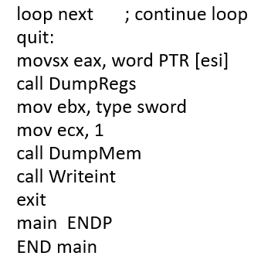
Option 2:
INCLUDE Irvine32.inc
.data
array SWORD -3,6,-1,-10,10,30,40,4 ,-40
sentinel SWORD 0
.code
main PROC
mov esi,OFFSET array
mov ecx,LENGTHOF array
next:
movsx eax, word ptr [esi]
or eax, eax
jns quit
add esi,TYPE array

Slide 50
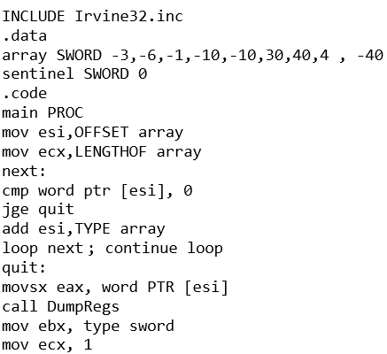
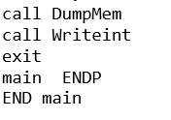
Option 3:

Slide 51
Exercise 1:
Create a procedure that returns the sum of all array elements falling within the range j...k (inclusive). Write a test program that calls the procedure twice, passing a pointer to a signed doubleword array, the size of the array, and the values of j and k. Return the sum in the EAX register and preserve all other register values between calls to the procedure. Display both the results.
Note:
Do include the documentation of your user-defined procedure
Hint:
You can use the USES operator for saving registers. Don’t use pushad/ popad here as result of procedure will be stored in EAX
Assume:
Array values: 30, -40, 20, 65, 80,45
j = 20 and k = 50 for 1st call
j = 35 and k = 90 for 2nd call

Slide 52
Exercise 2:
Create a procedure that saves the positive values of all array elements of an array1 in another array2. Write a test program that calls the procedure, passing a pointer to a signed doubleword array and the size of the array. Preserve all other register values between calls to the procedure.
Let elements of array1 be 40, -90, -67, 98, 78, -45, 0, 32.

Slide 53
Exercise 3:
If AL contains 1 or 3, display "o"; if AL contains 2 or 4, display "e".

Slide 54
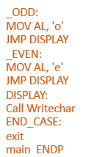
Solution: (option 1)
INCLUDE Irvine32.inc
.code
main PROC
mov eax,0
CALL ReadDec
CMP AL, 1
JE _ODD
CMP AL,3
JE _ODD
CMP AL, 2
JE _EVEN
CMP AL,4
JE _EVEN
JMP END_CASE

Slide 55
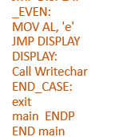
Solution: (option 2)
INCLUDE Irvine32.inc
.code
main PROC
mov eax,0
CALL Readchar
CMP AL, '1'
JE _ODD
CMP AL,'3'
JE _ODD
CMP AL, '2'
JE _EVEN
CMP AL,'4'
JE _EVEN
JMP END_CASE
_ODD:
MOV AL, 'o'
JMP DISPLAY
Note:
If you are calling procedure Readchar then while comparing do insert single quotes, as numbers will be treated as characters.

Slide 56


